Slide 1
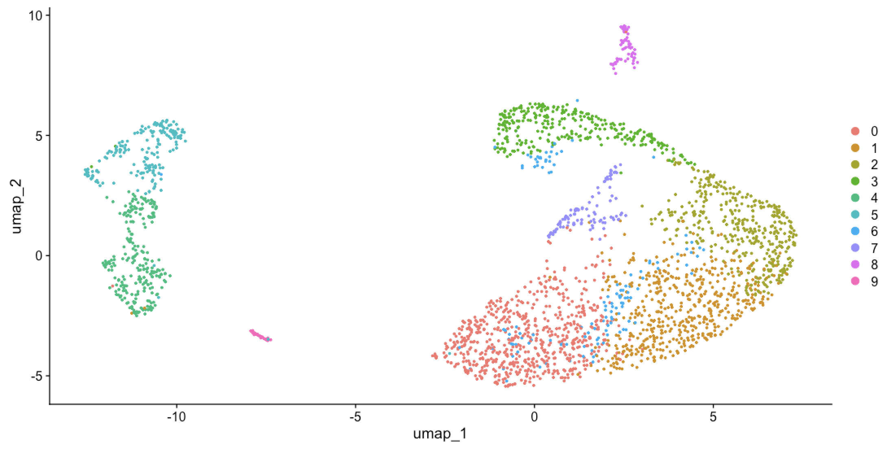
Exploring Microglial Heterogeneity: Transcriptomic Insights into Maternal Stress Responses
Nov. 1st 2024
NRSC 510A update presentation
By Krysia MacRae
Dr. Rosin lab

Slide 2
Overview
No previous experience in programming
Programming in R
scRNA-seq data
Tutor: Margo Kapustina

Slide 3
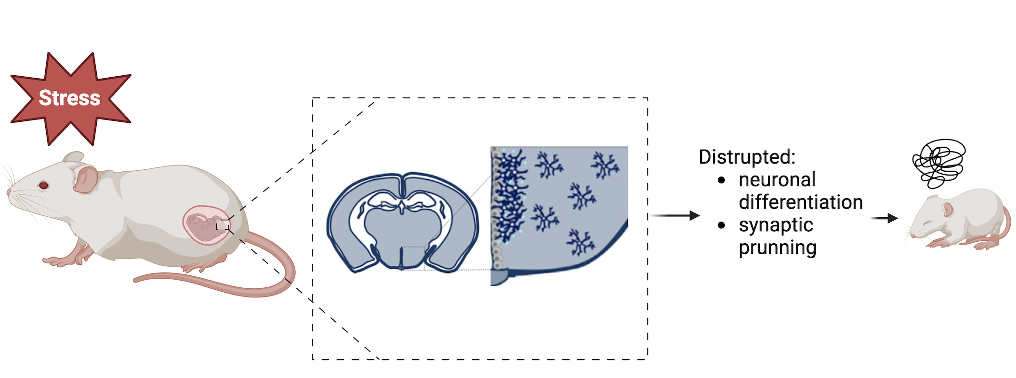
Background information
Introduction
Maternal stress disrupts offspring neurodevelopment, leading to long-term behavioural and cognitive challenges
Knowledge gap: how do hypothalamic microglia interact with neural cells to change their development?
Rosin, 2018
Notes:
Maternal stress is a serious issue that disrupts offspring neurodevelopment, leading to long-term behavioural and cognitive challenges.
It activates microglia (the brain’s immune cells) in the hypothalamus, which in turn affect neural progenitor development, affecting processes such as neuronal differentiation and synaptic pruning
But, the way in which hypothalamic microglia interact with neural cells to change their development is understudied.

Slide 4
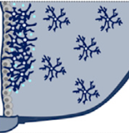
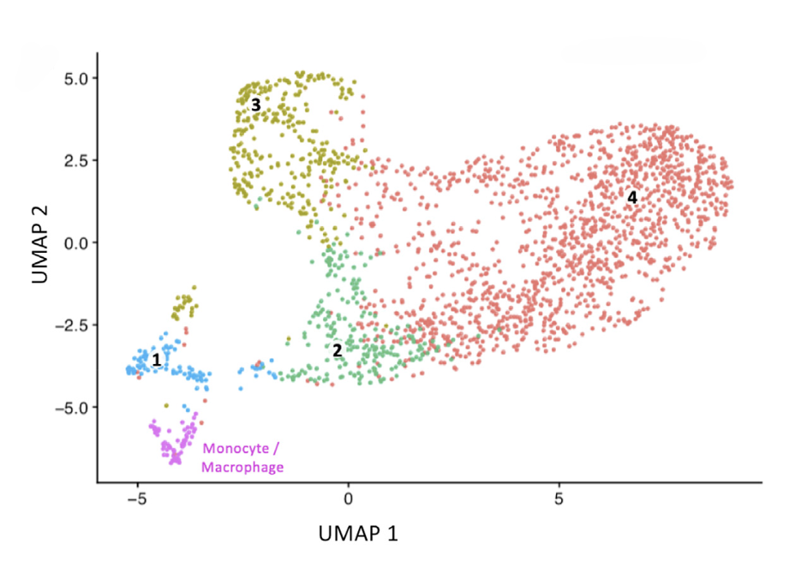
Rosin et al. (2021)
Introduction
Notes:
Rosin et al. address this gap and using a toolbox of techniques, including scRNA-seq, they found that there are four distinct microglial clusters of hypothalamic microglia, one of which is in direct contact with nearby NSCs and responded to maternal cold stress.
This is a UMAP plot visuazling 4 clusters of similar microglia based on their gene expression proflies. Here, increasing heterogeneity in the data is represented by the increasing distance between the data points.

Slide 5
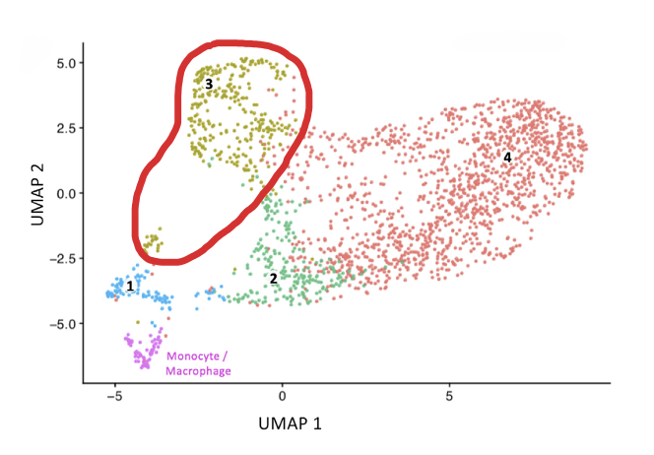
Research question
Introduction
How do transcriptomic differences, within a specific subtype of hypothalamic microglia identified in Rosin et al. (2021) reflect the heterogeneity in microglial responses to maternal stress?
Notes:
While Rosin et al. (2021) provide valuable insights into the role of stress-responsive microglia, the heterogeneity within microglial subpopulations remains underexplored.
I will try to answer the question: how do transcriptomic differences, within a specific subtype of hypothalamic microglia identified in Rosin et al. (2021) reflect the heterogeneity in microglial responses to maternal stress?
Specifically, I’ve decided analyze cluster 3, since it is the most heterogenous based on the UMAP plot
By exploring the heterogeneity within cluster 3, this project aims to improve our understanding of how microglial diversity impacts neurodevelopmental programs in response to maternal stress. These findings could help uncover underlying mechanisms involved in NDDs, enabling identification of vulnerable pathways for interventions to reduce these insults on the developing brain.

Slide 6


Updated timeline
Oct 3 – Nov 14 (Seurat):
- Replicating Dr. Rosin’s UMAP: loading files, merging data, quality control, data normalization, PCA, clustering
Subsetting cluster 3
Differential gene expression analysis
Nov 15 – 18 (clusterProfiler)
Pathway enrichment analysis
Nov 19-22 (fgsea)
Gene set enrichment analysis
Nov 23 – 30 (monocle3)
- Pseudotime analysis
Oct 3 – Nov 14 (Seurat):
- Replicating Dr. Rosin’s UMAP: loading files, merging/integrating data, quality control, data normalization, PCA, clustering
- Subsetting clusters with Dr. Rosin’s cluster 3 marker genes
- Differential gene expression analysis
Nov 15 – 18 (clusterProfiler)
Pathway enrichment analysis
Nov 19-22 (fgsea)
Gene set enrichment analysis
Nov 23 – 30 (monocle3)
- Pseudotime analysis
Notes:
October 3 – November 14: loading files, removing low-quality cells, normalizing data, ensuring integrity for subsequent analyses. Then, subsetting cluster 3, identifying and extracting the specific microglial population for analysis, and visualizing with UMAP. Conducting differential expression analysis to identify genes (Seurat).7
November 15 – 18: conducting pathway enrichment analysis to uncover pathways potentially affected by maternal stress (clusterProfiler).
November 19 – 22: performing Gene Set Enrichment Analysis to determine whether predefined gene sets (control and stress) show significant differences, providing insight into functional implications of transcriptomic changes observed (fgsea).
November 23 – 30: carrying out pseudotime analysis to investigate potential developmental trajectories of cells, offering insights into how stress may alter microglial development (monocle3).

Slide 7
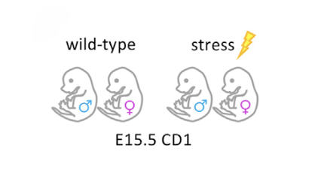
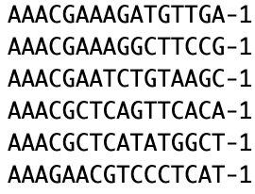
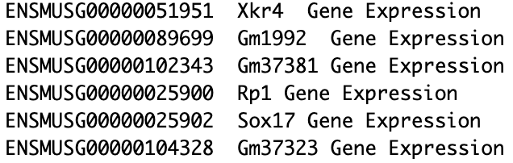
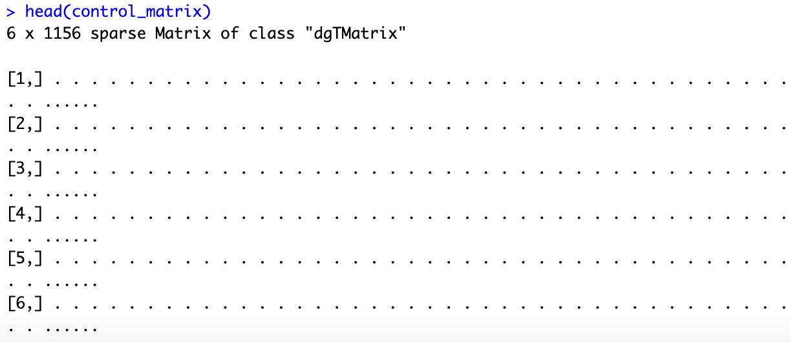
Datasets
barcodes.tsv :
features.tsv:
matrix.mtx:
Notes:
Rosin et al. used WT and stress CD 1 mice and consequently for each condition there are 3 files:
a file with the gene IDs, representing all genes quantified
a file with the cell IDs, representing all cells quantified
a matrix of counts per gene for every cell
Rows are associated with the gene IDs above and columns correspond to the cellular barcodes

Slide 8
Seurat analysis (major steps)
Preparing data
Quality control
Normalizing data
PCA
Clustering

Slide 9
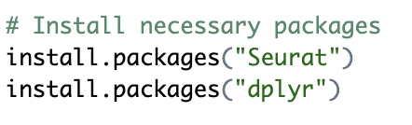
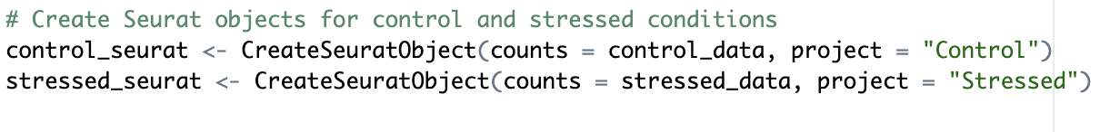
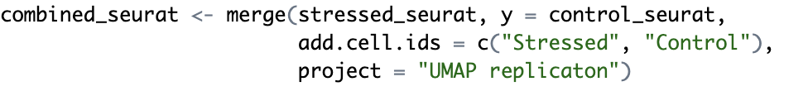
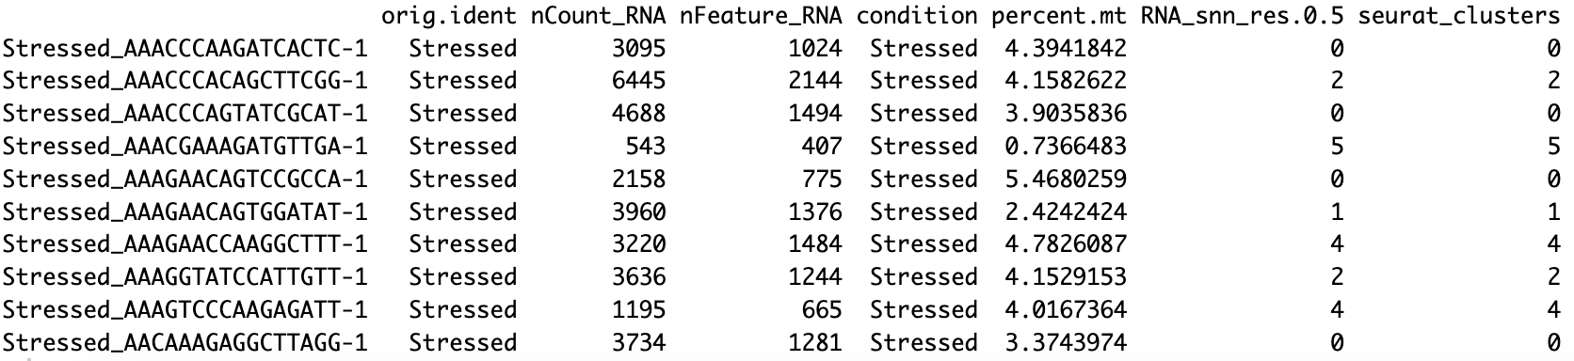
Preparing data
Progress
combined_seurat: [31053 x 2623]
Notes:
Your combined Seurat object is like a special data container that holds everything you need for analyzing your RNA sequencing data in one place. Think of it as a database for cells, with different “drawers” that store various types of information about each cell. Here’s a simplified view of what it contains:

Slide 10
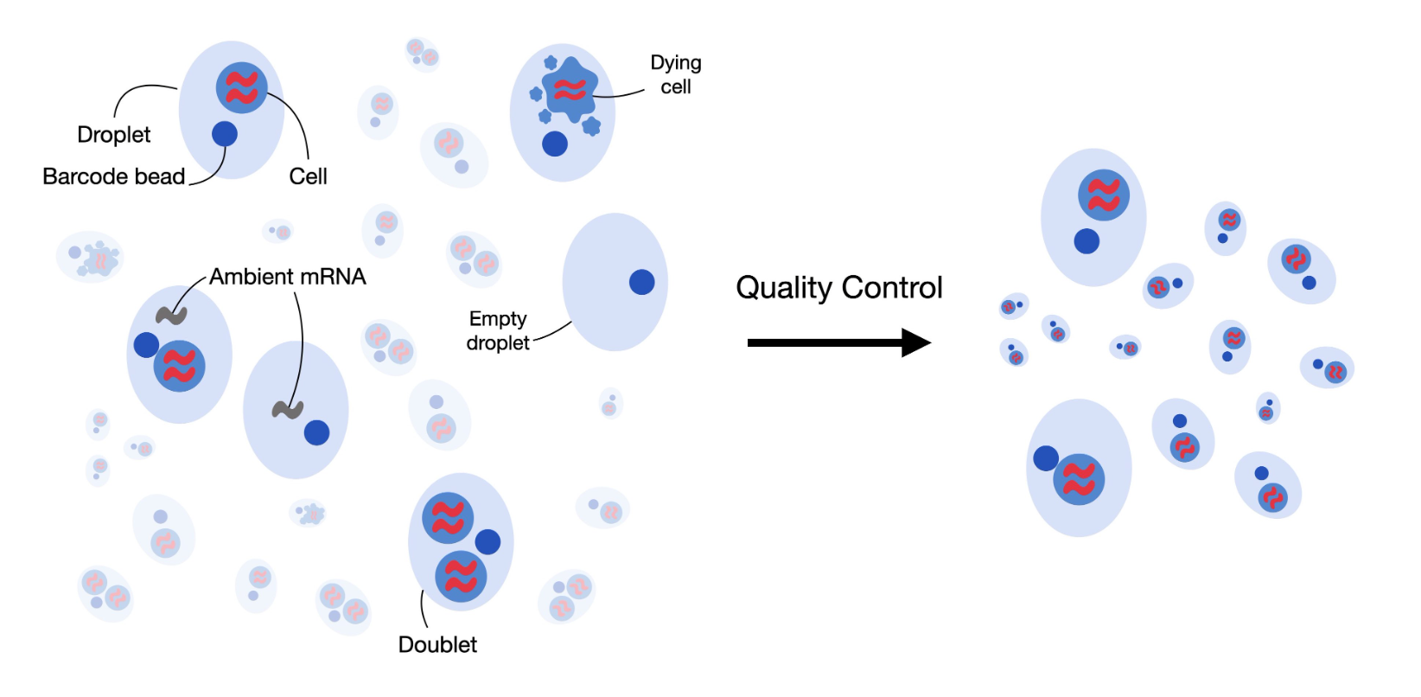
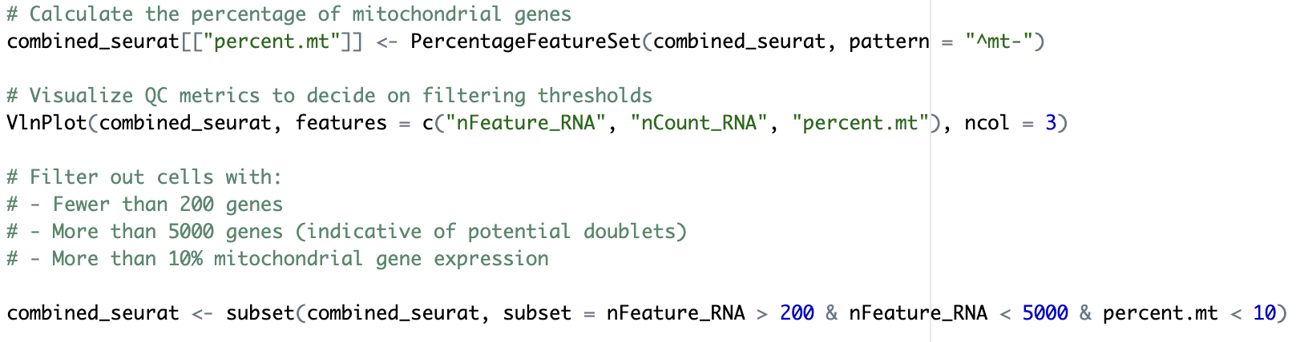
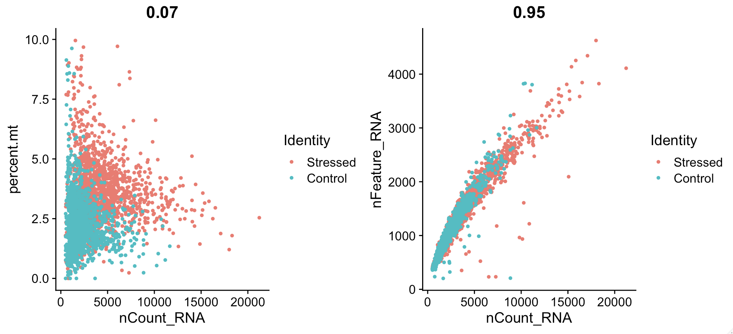
Quality control
Progress
combined_seurat: [31053 x 2568]

Slide 11
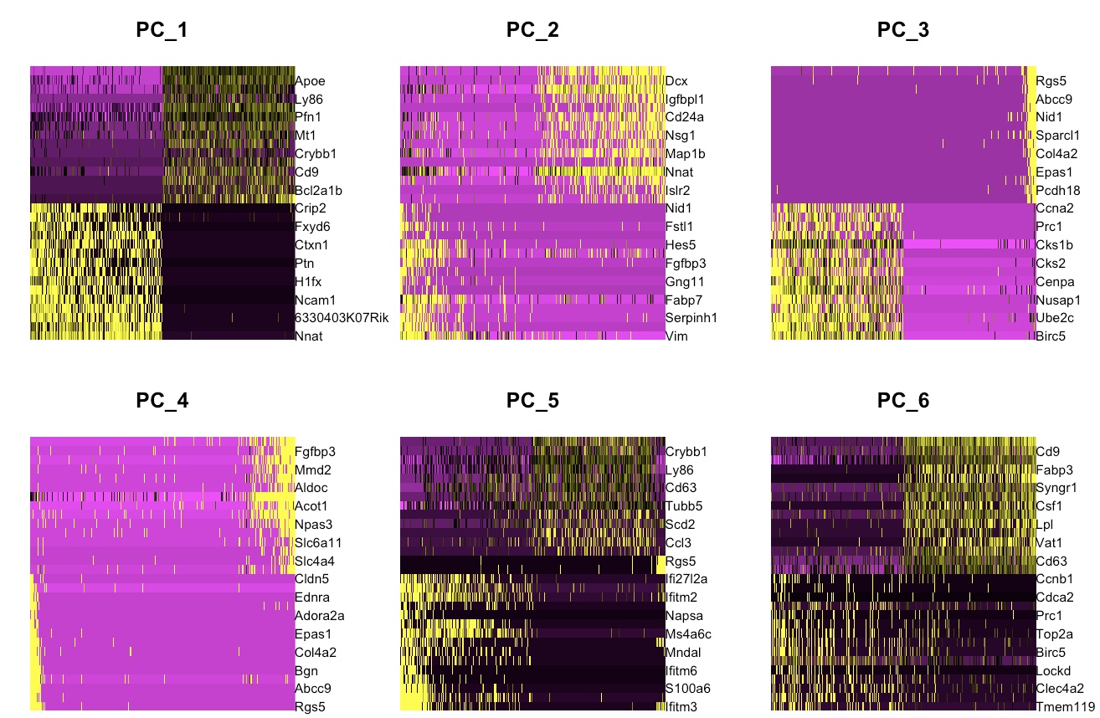
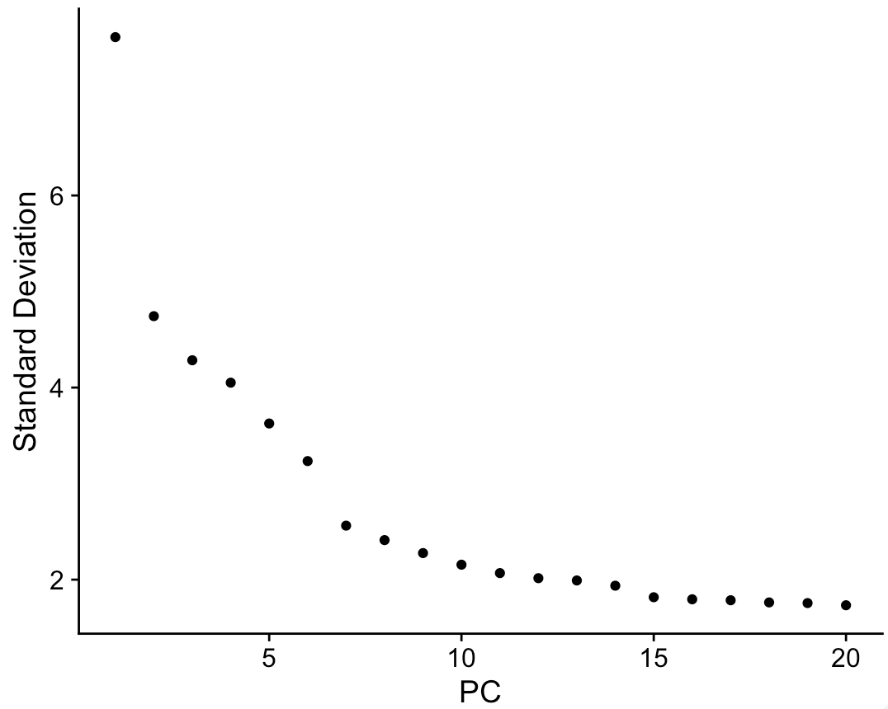
Normalizing data
Progress
Principal component analysis (PCA)
combined_seurat: [31053 x 2568]

Slide 12
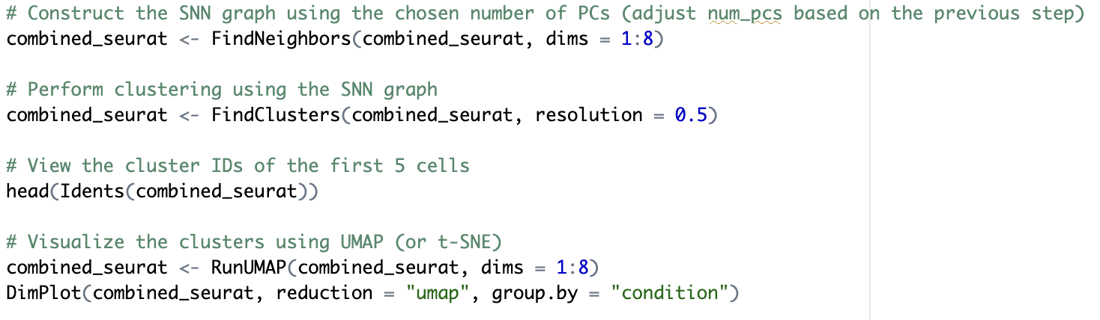
Clustering
Progress
combined_seurat: [31053 x 2568]

Slide 13
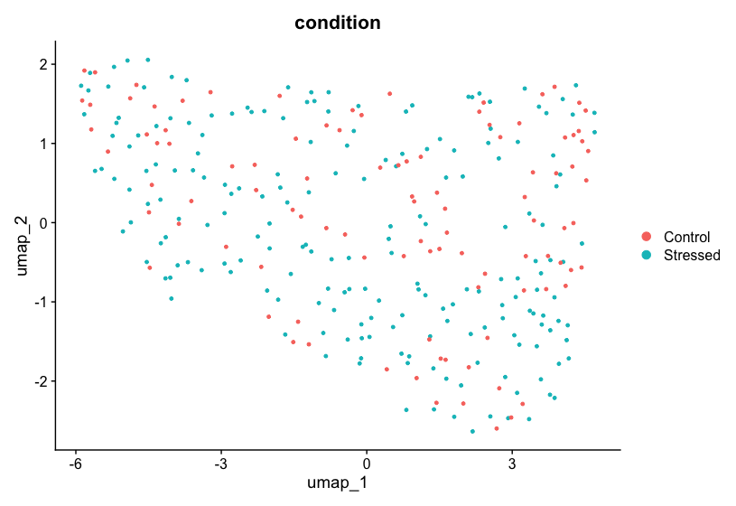
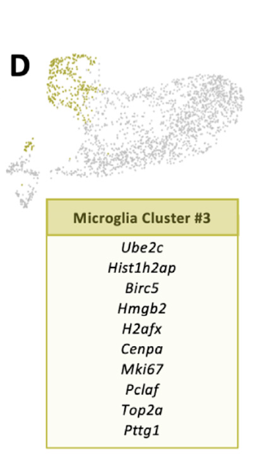
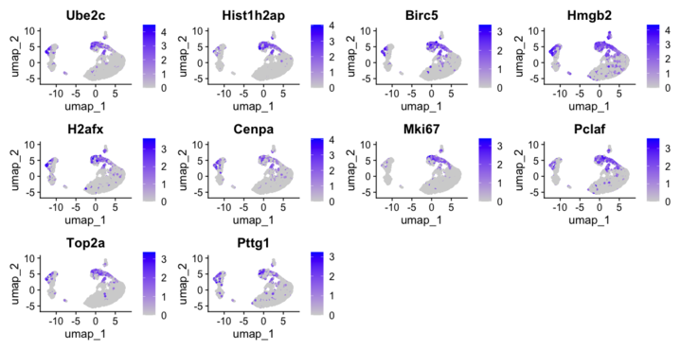
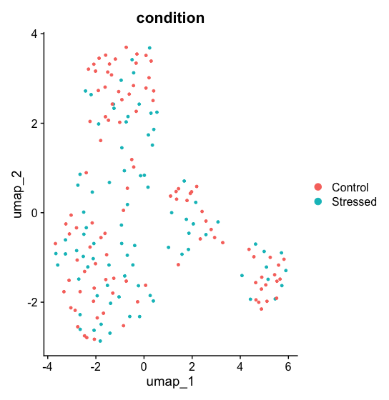
Finding Dr. Rosin’s cluster 3
Progress
Cluster 3
Dr. Rosin’s UMAP
Krysia’s UMAP
Cluster 5

Slide 14
Next steps
Merge vs integrate
Subset all clusters
Find most heterogenous cluster
Differential expression analysis
Pathway enrichement analysis
Gene enrichement analysis

Slide 15
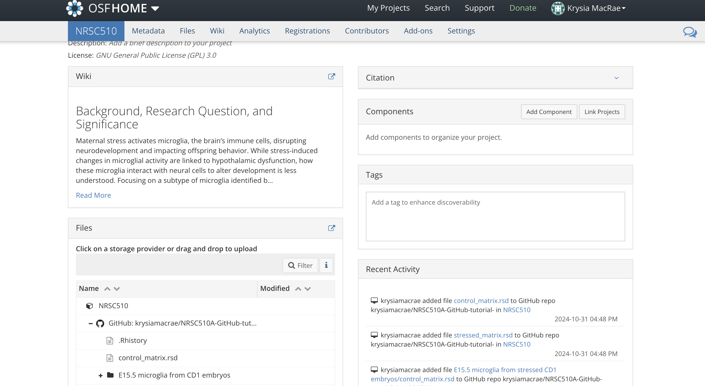
OSF page

Slide 16
Thank you

